Slide 1


clinic_management_system

Slide 2
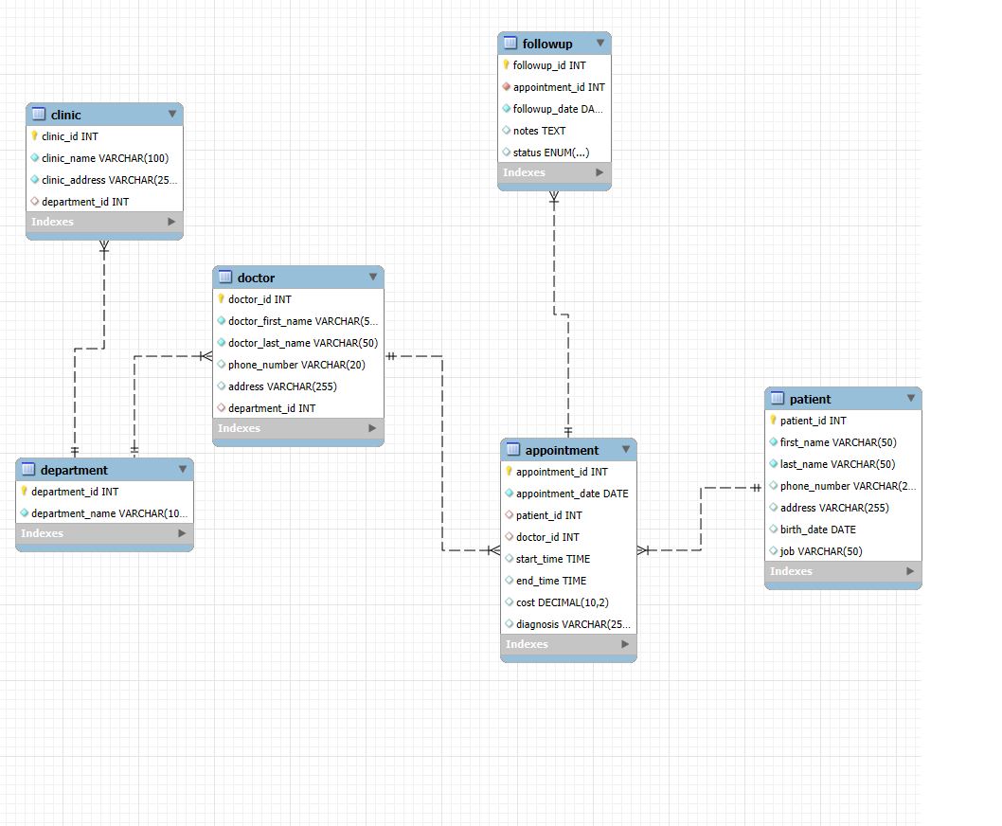

ERD PHOTO
Department ↔ Clinic → 1: N (One department has many clinics; each clinic belongs to one department) Department ↔ Doctor → 1: N (One department has many doctors; each doctor works in one department) Doctor ↔ Appointment → 1: N (One doctor has many appointments; each appointment has one doctor) Patient ↔ Appointment → 1: N (One patient can have many appointments; each appointment is for one patient) Appointment ↔ FollowUp → 1: N (One appointment can have many follow-ups; each follow-up is for one appointment)

Slide 3
department ( department_id INT PRIMARY KEY, department_name VARCHAR(100) NOT NULL ) patient ( patient_id INT PRIMARY KEY, f irst_name VARCHAR(50) NOT NULL, last_name VARCHAR(50) NOT NULL, phone_number VARCHAR(25) NOT NULL, address VARCHAR(255) NOT NULL, birth_date DATE NOT NULL, job VARCHAR(50) )
doctor ( doctor_id INT PRIMARY KEY, doctor_first_name VARCHAR(50) NOT NULL, doctor_last_name VARCHAR(50) NOT NULL, phone_number VARCHAR(20) NOT NULL, address VARCHAR(255) NOT NULL, department_id INT NOT NULL, FOREIGN KEY (department_id) REFERENCES department(department_id) )
clinic ( clinic_id INT PRIMARY KEY, clinic_name VARCHAR(100) NOT NULL, clinic_address VARCHAR(255) NOT NULL, department_id INT NOT NULL, FOREIGN KEY (department_id) REFERENCES
department(department_id) ) appointment ( appointment_id INT PRIMARY KEY, appointment_date DATE NOT NULL, patient_id INT NOT NULL, doctor_id INT NOT NULL, start_time TIME NOT NULL, end_time TIME NOT NULL, cost DECIMAL(10,2) NOT NULL, diagnosis VARCHAR(255), FOREIGN KEY (patient_id) REFERENCES patient(patient_id), FOREIGN KEY (doctor_id) REFERENCES doctor(doctor_id) )
followup ( followup_id INT PRIMARY KEY, appointment_id INT NOT NULL, followup_date DATE NOT NULL, notes TEXT, status ENUM('scheduled', 'pending', 'completed', 'cancelled') NOT NULL, FOREIGN KEY (appointment_id) REFERENCES appointment(appointment_id) )
Relational Schema for Medical Clinic Database:

Slide 4
Task
Overview

Slide 5
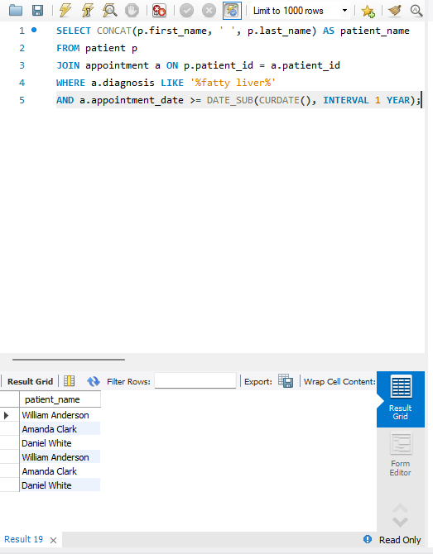
1.List the name of patients who were diagnosed with fatty liver in the last year

Slide 6
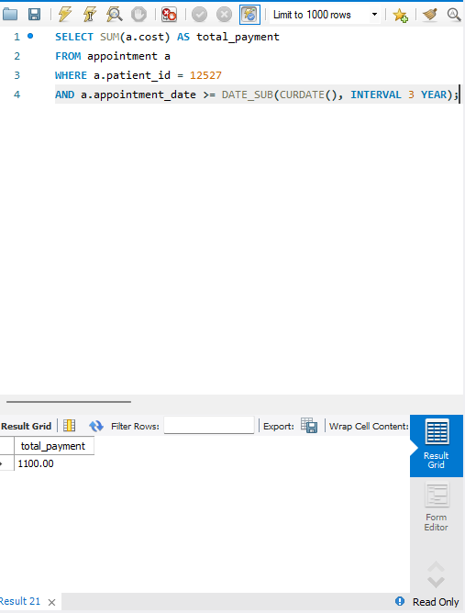
2• List the addresses of cardiology clinics.

Slide 7
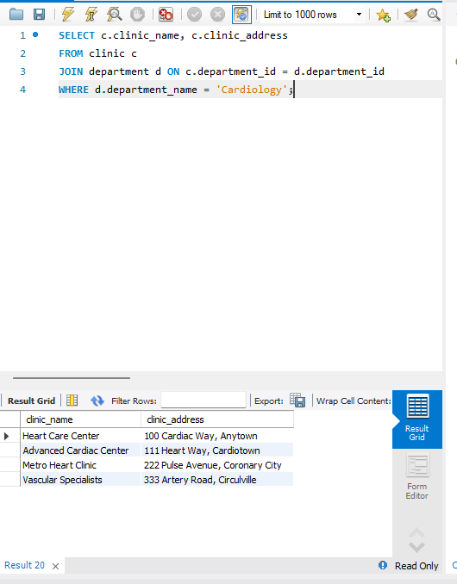
3• List the total money paid by a patient whose ID is 12527 in the last three years. y liver in the last year

Slide 8
Benefits and Impact
Saves time: Quick access to records; no more lost papers
Reduces human error: Digital system ensures accurate and complete data
Improves communication: All departments access the same up-to-date information
•Supports better decision-making: Fast, accurate reports help management spot trends and optimize resources

Slide 9
conclusion
Complete solution for healthcare data management
Organizes and protects patient information
Streamlines records, appointments, follow-ups, and departments
Improves workflow for healthcare providers
Enhances patient experience

Slide 10
THANK YOU!

